Slide 1
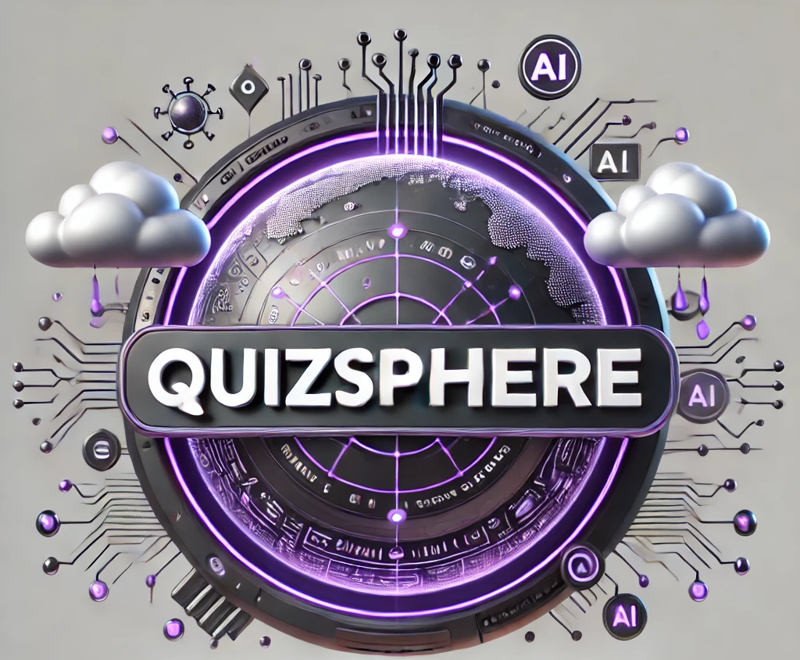
COSMOCLOUD HACKATHON
Theme( EdTech)
QuizSphere
Personalized Certification & Quizzes
“Empowering Cloud Certification Success with Generative AI”
Team: COSM40D0

Slide 2







PROBLEM TO SOLVE
IT professionals face tight deadlines for completing cloud certifications (AWS/Azure).
Exams cover vast, complex topics, making preparation overwhelming.
Resources currently available lack customization and adaptability to individual learning needs.
Limited availability of real exam-like questions for effective practice.
High costs and limited chances for exam retakes increase pressure on professionals.
No targeted solutions to help users focus on key topics and efficiently manage study time.

Slide 3

The Solution
QuizSphere: A web app using generative AI to create personalized, dynamic quizzes for cloud certification topics (AWS/Azure).
Provides customized study plans tailored to individual strengths, weaknesses, and time constraints.
Adaptive quizzes: AI-generated quizzes evolve based on user performance and selected certification areas.
Real-time study plan updates based on quiz results and progress.
User-centric design : Focuses on efficient preparation for cloud certifications, benefiting both students and IT professionals.
Tracks user’s certification path and performance to continuously refine content delivery.

Slide 4
How CosmoCloud Is Used?
MongoDB Backend : We will use CosmoCloud to manage the backend, including storing and processing user data such as profiles, certification preferences, learning goals, and quiz results.
MongoDB Vector Search : This feature will enable efficient querying of vector embeddings for certifications, allowing quick, relevant question generation.
Real-Time Progress Tracking: By using CosmoCloud, we will track quiz performance and study progress to refine quiz content and study recommendations for users.

Slide 5
Use of GenAI
AI is used in several aspects of the project:
Dynamic Quiz Generation: AI generates questions based on the user’s selected certification topics and adapts to their performance.
Personalized Study Plans: AI customizes study plans based on individual progress and goals, making real-time adjustments using performance analytics.
Contextual Question Generation: AI will generate questions and explanations that are contextually relevant, ensuring they reflect real exam patterns and topics.

Slide 6







TOOL SET
CLOUD

Slide 7
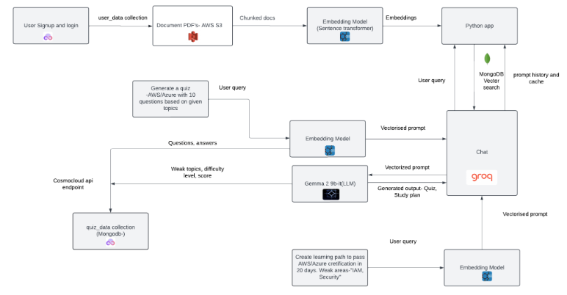
ARCHITECTURE
DIAGRAM

Slide 8
Backend Structure -MongoDB and Cosmocloud
User Collection (user_data): Stores user information, including username, email, password, and certification path.
Quiz Collection (quiz_data): Records attempted questions, answers, and scores for each user.
Study Plan Collection (study_plan): Contains weaker topics, resource links, and proficiency levels to guide study efforts.
Certification Vectors Collection (cert_vectors): Holds certification type, chunk index, text, and vector embeddings for personalized content delivery.
User ID Reference: Each collection utilizes a user_id as a foreign key to associate data with the logged-in user.

Slide 9
Q&A
Personalized Certification & Quizzes
THANKYOU

